Slide 1
Why I wrote a LISP interpreter and why you should too
Tommy Stopak
Advisor: Dr. Li Feng

Slide 2
What we will talk about today
LISP
Why you should consider writing your own LISP

Slide 3

When many of you think of a LISP you may think of

Slide 4
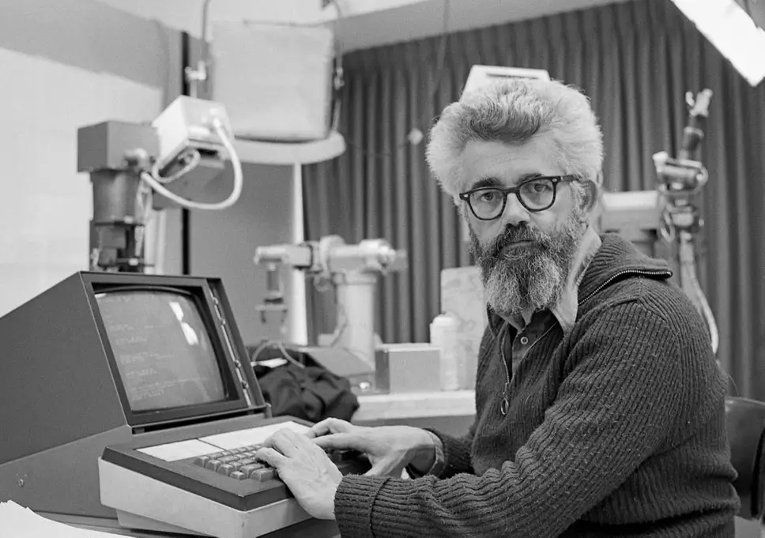
When I think of a LISP I think of

Slide 5
Who was that?
John Mccarthy (1927-2011)
Stanford Professor
A father of AI
Inventor of LISP
Turing Award Winner

Slide 6
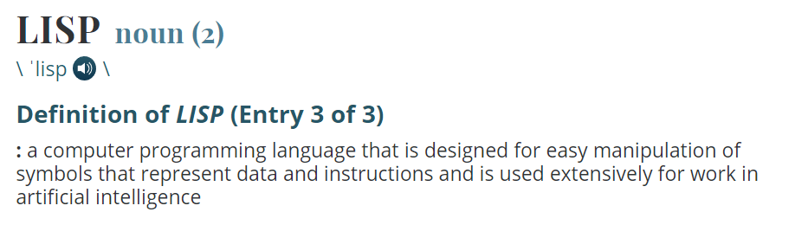
LISP as defined by Merriam Webster

Slide 7
LISP as defined by me
One of the best programming languages ever.

Slide 8
So why the name LISP?
We are bad at (and yet still love) acronyms.
Ex: WYSIWIG, GNU, PICNIC
LIS = List
P = Processor
LISP = List Processor

Slide 9
What makes LISP so great?
Minimal syntax.
Functional.
The way of the future.

Slide 10
Minimal Syntax
Syntactic roots in the Lambda Calculus
λxy.x+y
Only syntax in lisp is parentheses and symbols.
In LISP:
(defun add (x y) (+ x y))
(add 5 6)

Slide 11
Functional
Programming with functions and not objects.
Side effects pushed to the outside.
Eliminates state.
Easy concurrency
First class functions

Slide 12
Why could this be the way we see programming move in the future?
Because Moore’s law is failing.

Slide 13
What is Moore’s law?
Gordon Moore
Forecast of future of chip technology.
Predicted doubling trend would continue.
Implications
For a very long time he was right.

Slide 14
What’s the catch?
Pushing the boundaries of physics.
Intel Ice Lake
Implications

Slide 15
Ok so maybe I should learn LISP. But why actually write one?
Learn more about the inner-workings of programming languages.
Gain a deeper understanding of LISP.
Improve or create skills in the language you are implementing the LISP in.
Minimal syntax and can be easily implemented.

Slide 16
If LISP is so powerful why is it so easy to implement
Almost no syntax, so parsing it is a breeze.
Written in a manner that creates the abstract syntax tree for you.
You can implement it in any language.
REPL

Slide 17

I wrote mine in Go.
Mostly because I like the mascot.

Slide 18
A little about Go
Created at Google
Created by Ken Thompson, Rob Pike, and Rob Griesmer
Often used for high performance back-end computing (Ex: Netflix Microservices)
C based language, with no objects and minimal standard libraries.

Slide 19
About my implementation
Named gLisp
Can currently only handle integers and basic strings
Not up to the CLHS by any means
Currently only takes REPL input

Slide 20
My Stack
Golang 1.1.5
Git & Github
GoLand

Slide 21
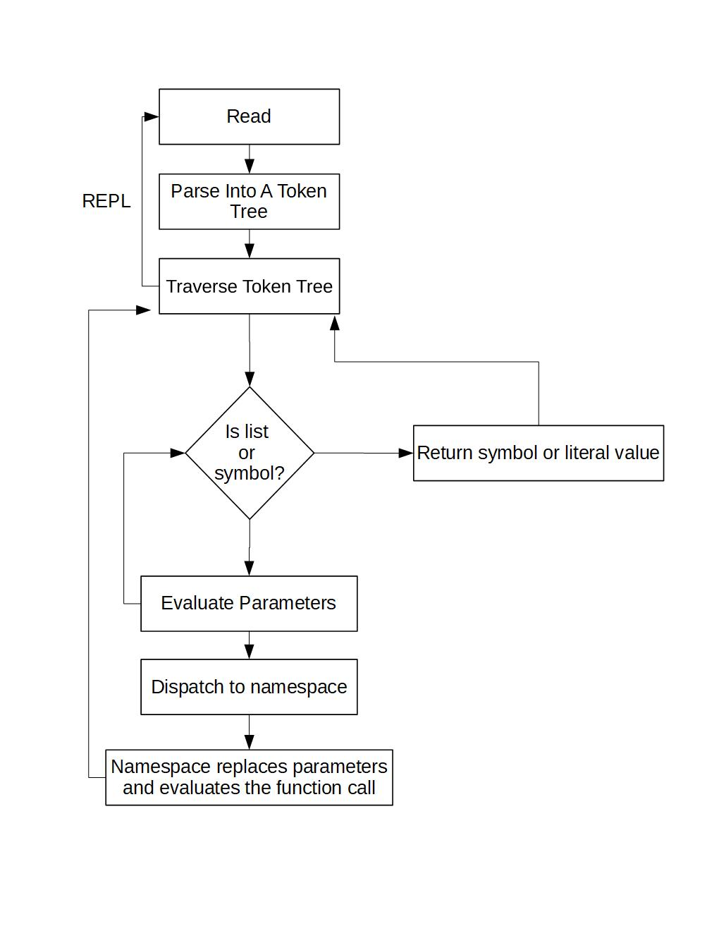
High level code overview

Slide 22
What I took away from the experience
Skills in a programming language I had never used before.
A much deeper understanding of LISP.
An appreciation for languages with many syntactic forms.
Patience.
A thorough understanding of recursion.

Slide 23
Where I want to take this in the future
More data types
Better error handling and error messages
Goroutines
Macros
Full implementation of the CLHS
Compiling with LLVM

Slide 24

Fork me on github @tstopak
I made the repository for the language public, and would appreciate any contributions.

Slide 25
Sources
1965: "Moore's Law" Predicts the Future of Integrated Circuits. (n.d.). Retrieved March 08, 2019, from https://www.computerhistory.org/siliconengine/moores-law-predicts-the-future-of-integrated-circuits/
Frequently Asked Questions (FAQ). (n.d.). Retrieved March 08, 2019, from https://golang.org/doc/faq#history
John McCarthy. (n.d.). Retrieved March 08, 2019, from https://www.computerhistory.org/fellowawards/hall/john-mccarthy/
LISP. (n.d.). Retrieved March 08, 2019, from https://www.merriam-webster.com/dictionary/lisp
Simonite, T. (2017, February 06). Moore’s Law Is Dead. Now What? Retrieved March 5, 2019, from https://www.technologyreview.com/s/601441/moores-law-is-dead-now-what/
Warren, T. (2019, January 07). Intel demonstrates 10nm Ice Lake processor, promises PCs will ship with it later this year. Retrieved March 08, 2019, from https://www.theverge.com/2019/1/7/18171718/intel-ice-lake-10nm-processor-dell-demo-ces-2019

